Slide 1

Marketing Cloud Engage Reverse Demo
​ Presenter: Russ Cordingley​
21st August 2026

Slide 2

Topics covered
Subject | Owner
Org Architecture | Russ
Platform Configuration | Russ
Sales Cloud Data Model | Russ
CRMA | Jordan
Data 360 | Russ
Other Integrations | Russ
Consent Management | Nathalie
Contact Deletion | Himanshu
Centralized form Processor | Nathalie
Other Forms | Nathalie
Preference Management | Nathalie
Sales Cloud task creation for lead gen | Russ
Campaign Member Status | Nathalie
#DigitalExcellence

Slide 3
Org Architecture

Slide 4
SFMC Org Diagram
KPMG US MID: 514007235
DEV MID: 514013583
QA Project MID: 514028729
UAT MID: 514019512
UAT Project MID: 514029578
DataCldPOC MID: 514035875
Playground MID: 514037499
KPMG US Child MID: 514031552
Name | Description | Users | Integration with SF | Org ID
DataCldPoC | US-Data Cloud POC Business Unit | 30 | Not Integrated
DEV | Connect to QA Environment in Sales Cloud | 107 | Integrated | 00DhE000000TNkPUAW (SF Dev Org)
KPMG US | Production Business Unit for KPMG US Marketing Operations | 554 | Integrated | 00D4W000005iRxVUAU (SF Prod Org)
KPMG US Child | Future State Production BU | 21 | Not Integrated
Playground | Dedicated Business Unit for exploratory efforts (Internal Comms) | 23 | Not Integrated
QAProject | Business unit for QAProject Testing | 65 | Integrated | 00DbY00000G6xaTUAR (QA project Org)
UAT | Connect to UAT Environment in Sales Cloud | 110 | Integrated | 00DhE000000ANUnUAO (UAT Org)
UATProject | BU for UATProject Regression Testing | 64 | Integrated | 00DhE0000016tFlUAI (UAT Project Org)

Slide 5
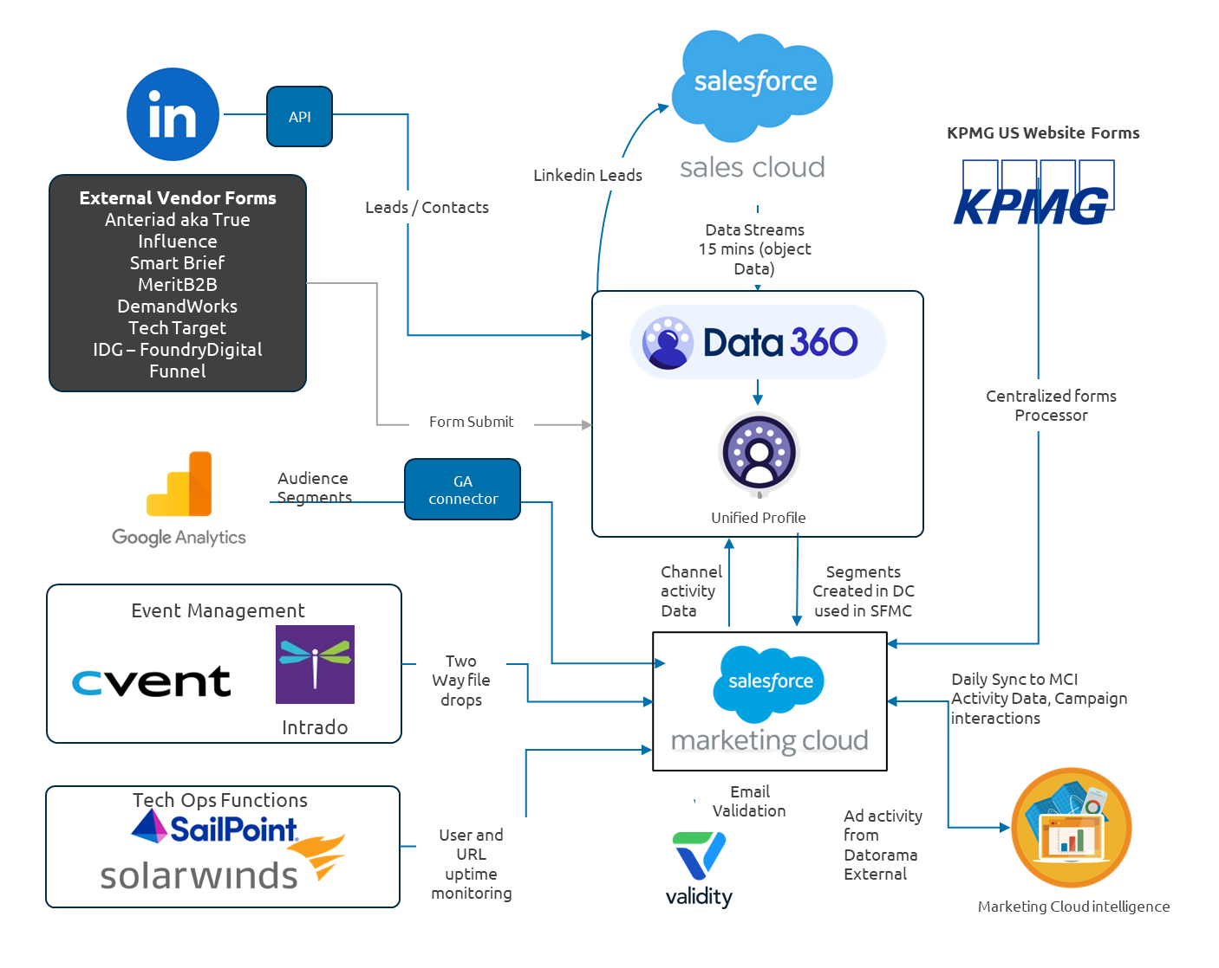
External Systems architecture
Notes:
This diagram illustrates the key integrations within the KPMG US marketing ecosystem. External lead providers, website forms, event management platforms, and Google Analytics provide customer and engagement data that supports marketing operations. Data Cloud acts as the central customer data platform, bringing together multiple data sources to create unified customer profiles and audience segments.
Salesforce Marketing Cloud is the primary campaign execution platform and consumes segments generated within Data Cloud for activation. Salesforce Sales Cloud is connected to Marketing Cloud using the standard Marketing Cloud Connect integration, enabling synchronization of CRM data and marketing engagement activities. In addition, LinkedIn Lead Gen form submissions are integrated directly with Marketing Cloud to support lead capture and nurture journeys.
Campaign activity, engagement metrics, and marketing performance data are subsequently made available to Marketing Cloud Intelligence for reporting and analytics, while supporting services such as Validity, SailPoint, and SolarWinds provide email validation, identity management, and operational monitoring capabilities.

Slide 6
Platform configuration

Slide 7
Account Security
Identity Provider
SSO
Business Unit Access
Assigned by role
Platform Roles
Least privilege
BU access
BU | Tech Leads | Campaign Managers | Analysts | Segmentation Team | SFMC Dev Team | D360 Dev Team | AMS Team | Dev Team | QA Team | Business Stakeholders | Internal Comms Team
KPMG US | ✓ | ✓ | ✓ | ✓ | ✓ | ✓ | ✓ | ✓ | ✓ | ✓
DEV | ✓ |  |  |  |  | ✓ | ✓ | ✓ | ✓ | ✓
UAT | ✓ |  |  |  |  | ✓ | ✓ | ✓ | ✓ | ✓
DataCldPOC | ✓ |  |  |  | ✓ | ✓
UAT Project | ✓ |  |  |  |  |  |  | ✓ | ✓ | ✓
QA Project | ✓ |  |  |  |  |  | ✓ | ✓ | ✓ | ✓
KPMG US Child | ✓ |  |  |  |  |  | ✓ | ✓
Playground | ✓ |  |  |  |  |  |  |  |  |  | ✓
Installed Packages
DEV_DEFAULT_API
Centralized API package used across the DEV environment for integrations, data operations, and Journey execution.
Tableau CRM & Einstein Discovery
Used by the CRMA team to support Tableau CRM and Einstein Discovery analytics capabilities.
KPMGUS_PRIVILEGE_API
Used for privileged Marketing Cloud API operations, including Journey management, Automation execution, audience management, and Data Extension access. Intended for functions requiring elevated permissions.
KPMGUS_DEFAULT_API
Used by CFP CloudPages and for all Journey-related operations, including triggering, updating, and stopping Journeys.
UAT_DEFAULT_API
Centralized API package used across the UAT environment for integrations, data operations, and Journey execution.
Notes:
The profile provides access to configure and manage Marketing Cloud features required for implementation activities but does not permit customer data exports. The Administrator (Privileged) profile provides full platform administration capabilities, including the ability to export data, and is restricted to a small group of approved users. From the KPMG team, privileged access is limited to Gavin Clark and David, while from the Capgemini team it is limited to Russ Cordingley and Sandeep, ensuring that data export capabilities are tightly controlled and auditable.

Slide 8

Sending Setup
Marketing communications
1,500 Sender Partner Profiles
2 Send Classifications
1 Delivery Profile

Slide 9
Platform Integrations
Source systems
Integration services
SFMC data layer
Processing layer
Execution / Ops
Sales Cloud
MC Connect
Shared DEs
Import activity
Journey entry
Data 360
Marketing Cloud Engagement Connection
Shared DEs
Email sends
Website forms
→
Centralized Form Processor
→
Contact Builder
→
MC Connect
→
Alerts
Representation principle: show the operating pattern, then link to detailed configuration only when needed.

Slide 10
Sales Cloud Data Model

Slide 11
Sales Cloud Data Model – Core Objects
1
Account
Account Contact Relationship
Account Firm Details
Account Team Member
Attendee
Currently 20 objects synced from Sales Cloud with Contact Point Phone Currently pasued as Data is now currently used in SFMC
Campaign
Campaign Alliance
Campaign Member
Campaign Member History
Campaign Member Status
Contact
Contact Point Email
Contact Point Phone
Cvent Attendee Activity
Cvent Event
3
Event Campaign Entry
Individual
Individual Firm Details
Lead
Tag

Slide 12
Sales Cloud Data Consumption By Marketing Cloud
Source of record
Selection / sync
Segmentation layer
Execution layer
Reporting / feedback
Sales Cloud
Controlled extract / sync
Data 360 / segmentation
SFMC Engage
Reporting
• Account
• Contact
• Lead
• Campaign
• Campaign Member
• Confirmed objects only
• Selected fields
• Refresh cadence
• Access controls
• Identity handling
• Audience rules
• Eligibility logic
• Activation outputs
• Shared / local DEs
• Journey entry
• Personalisation
• Email sends
• Campaign response
• Engagement data
• Lead follow-up
• Pipeline impact
System of record
System of segmentation
System of execution
Sales Cloud owns CRM objects and IDs.
Data 360 or SFMC rules create targetable audiences.
SFMC executes sends and journeys.

Slide 13
Example 3 — Design Decisions to Capture
Use this slide to make the Sales Cloud data model useful for architects, marketers and operations teams.
Identity standard
Contact vs Lead handling
Marketing attributes
Which CRM ID becomes the marketing Contact / Subscriber Key?
Are Contacts and Leads both marketable, and how are converted Leads treated?
Which fields are approved for segmentation, personalisation and reporting?
Campaign membership
Data ownership
Downstream availability
When are Campaign Members created, and what status model is used?
Who owns data quality, field definitions and permitted use?
Which objects flow to Data 360, SFMC, CRMA or other systems?
High-level output expected
A clear view of which Sales Cloud objects and relationships are used by marketing, what data is trusted, and what must be validated before downstream activation.

Slide 14
CRMA

Slide 15
CRMA Data Inputs
DATA SOURCES
DATA Processing (SFMC) Side
CRMA LAYER
Sales Cloud
Prepare
Campaigns, Leads, Contacts, Accounts
Pipeline / opportunity data
Recipes / dataflows
Ingest, Join, transform, validate
SFMC Engagement/MCI Campaign Data
Email / journey engagement data
Send, open, click, bounce, unsubscribe
Governed datasets
Certified data products
Refresh cadence & lineage

Slide 16
CRMA Data Ingestion
1
Source systems
2
Ingest & secure
3
Prepare data
4
Datasets
5
Dashboards
Sales Cloud
SFMC Engagement
Connectors / recipes
Authentication
Access boundaries
Join and transform
Apply KPI logic
Validate quality
Certified data sets
Refresh schedule
Lineage & ownership
Business dashboards
Filters & lenses
Executive views
Key design decisions to represent
Keep at high level
• Confirm source feeds and data ownership
• Define refresh cadence and data latency expectations
• Identify which datasets are certified or business-approved
• Make security model visible: app permissions, sharing and row-level filters
• Avoid full CRMA implementation detail
• Show datasets and dashboard domains, not every lens
• Mark unknown integrations or dashboard ownership as TBC
• Separate analytics from operational processes

Slide 17
Technical Controls

Slide 18
Technical Controls

Slide 19
CRMA configuration & governance points to validate
Decision checklist
This slide turns the CRMA overview into the questions needed to finalize the architecture pack.
Data sourcing
• Confirmed source systems
• Object / dataset scope
• Refresh cadence
• Historical retention
Security & access
• App permissions
• Dashboard sharing
• Row-level security
• Executive access
Architecture pack output: show CRMA as a governed analytics layer, with confirmed sources, certified datasets and dashboard consumers.
Definitions
• KPI definitions
• Campaign response logic
• Pipeline influence rules
• Source of truth
Operations
• Refresh failure alerts
• Dashboard ownership
• Enhancement backlog
• Support route
Use “TBC / validate with current implementation” for any unknown CRMA feeds, dashboard ownership, security model or operational write-back.
CRMA topic example • Slide 4

Slide 20
Data 360

Slide 21
Architecture
Marketing Cloud Engagement data is ingested through the native MCE Connector.
Email Engagement, Einstein Email Engagement Scores, and Engagement Topics are incorporated into the Data Cloud model.
Subscriber Key is used as the primary linkage between Marketing Cloud Engagement records and Data Cloud Individuals.
Engagement behavior is connected to CRM, campaign, account, and contact data to support unified audience activation and analytics.

Slide 22
Architecture
Marketing Cloud Engagement data is ingested through the native MCE Connector.
Email Engagement, Einstein Email Engagement Scores, and Engagement Topics are incorporated into the Data Cloud model.
Subscriber Key is used as the primary linkage between Marketing Cloud Engagement records and Data Cloud Individuals.
Engagement behavior is connected to CRM, campaign, account, and contact data to support unified audience activation and analytics.

Slide 23
Connector → Segment → Activation → Shared DEs
Data 360 acts as the segmentation and activation layer: data is connected into Data 360, segments are created there, then activated into SFMC Shared Data Extensions for campaign execution.
SOURCE DATA
CONNECTOR / INGESTION
DATA 360
ACTIVATION
SFMC EXECUTION
Salesforce & other sources
Data 360 connectors
Model & segment
SFMC activation
Shared DEs
Sales Cloud data
SFMC engagement data
External feeds where confirmed
Connected sources create/update data streams
Refresh cadence to be validated
Data model
Identity/unification where used
Segment rules created in D360
Activation target: MC Engagement
Fields mapped for send use
Schedule controlled in D360
Shared audience DEs
Consumed by child BUs
Journeys / sends
What this topic should make clear
• Data 360 is the segmentation decision point, not the send engine
• Activation creates or updates Shared Data Extensions in SFMC
• SFMC Business Units consume the activated Shared DEs for journeys and sends
• Consent / preference rules should be handled by the separate consent architecture section
Use this as an architecture-level view. Replace source systems, objects, DE names and refresh cadences with the confirmed implementation details.
Data 360 integration example • Slide 1

Slide 24
Data 360 connector and data readiness pattern
How data becomes segmentable
Represent the connector as the controlled path that makes source data available in Data 360 for modelling, identity and segmentation.
1
Connected source
2
Connector setup
3
Data streams
4
Data model
5
Ready to segment
Example: Sales Cloud, SFMC engagement bundle or approved external feed
Connection, auth, object selection and refresh schedule
Data lands in Data 360 and is kept refreshed by the connector
Map source fields to the customer data model / DMO layer
Profiles, attributes and relationships available to segment rules
Represent at high level
Data checks before segmentation
Avoid too much detail
• Source system
• Connector type
• Object / data category
• Refresh or latency expectation
• Key identifiers populated
• Required attributes available
• Relationship model validated
• Expected record volumes confirmed
• No full field mapping table
• No DMO-by-DMO build notes
• No consent rule detail here
• Use TBC for unconfirmed sources
Example wording: “A typical Data 360 connector refreshes selected source data into Data 360, where it is mapped and made available for segment creation.”
Data 360 integration example • Slide 2

Slide 25
Segment-to-activation flow into SFMC Shared Data Extensions
D360 creates the audience; SFMC executes
This is the core flow to show: segments are built in Data 360 and activated into Shared Data Extensions so the relevant SFMC Business Units can use them.
1. Segment in Data 360
2. Activation target
3. Field mapping
4. Shared DE output
5. Campaign use
Business segment rules
Audience membership calculated
Segment owner / criteria documented
Destination: Marketing Cloud Engagement
Activation schedule
Attribute selection
Contact / Subscriber Key
Email address or contact point
Campaign attributes required by SFMC
Activated audience written to Shared DEs
Controlled folder/location
Consumed by child BUs
Journey entry source
Email Studio send
Campaign reporting input
Example Shared Data Extension pattern
Business Unit consumption pattern
• SHARED_D360_SEG_<AudienceName>
• Primary identifier aligns to SFMC Contact / Subscriber Key standard
• Only fields required for execution are activated
• Shared DE is visible to authorised child BUs
• BU journeys/sends use the DE as the audience source
• BU teams do not rebuild the segment logic locally
Do not present example DE names or field mappings as final. Use them to show the pattern unless the actual names and mappings are confirmed.
Data 360 integration example • Slide 3

Slide 26
Data 360 activation: design decisions to validate
Architecture checklist
Use this slide to turn the integration view into the decisions needed before build or sign-off.
Identity & keys
• Contact / Subscriber Key standard
• Email/contact point selection
• Lead vs Contact handling
• Deduplication expectation
Activation design
• Activation destination
• Activation schedule
• Full refresh vs incremental behaviour
• Required attributes only
Core principle: Data 360 owns segment logic; SFMC Shared DEs provide the reusable audience output for campaign execution.
Shared DE design
• Folder and naming convention
• Primary keys
• Retention / archive approach
• BU visibility model
Operations
• Monitoring and failure alerts
• Record-count reconciliation
• Owner for each segment
• Issue triage route
Explicitly separate this from consent/preference architecture. This topic can show where eligibility attributes are consumed, but not define the consent model.
Data 360 integration example • Slide 4

Slide 27
Consent Managment

Slide 28
Technical Controls
Technical controls
API access
SFTP
encryption mechanisms where applicable
platform auditability
retention principles
operational access controls

Slide 29
Contact Deletion

Slide 30
Technical Controls
Technical controls
API access
SFTP
encryption mechanisms where applicable
platform auditability
retention principles
operational access controls

Slide 31
Centralized form Processor

Slide 32
Technical Controls
Technical controls
API access
SFTP
encryption mechanisms where applicable
platform auditability
retention principles
operational access controls

Slide 33
Centralized Form Processor: high-level architecture
Connector → Segment → Activation → Shared DEs
Centralized Form Processor serves as the data processor for SFMC Forms.
1
1
1
1
1
Salesforce & other sources
Data 360 connectors
Model & segment
SFMC activation
Shared DEs
Sales Cloud data
SFMC engagement data
External feeds where confirmed
Connected sources create/update data streams
Refresh cadence to be validated
Data model
Identity/unification where used
Segment rules created in D360
Activation target: MC Engagement
Fields mapped for send use
Schedule controlled in D360
Shared audience DEs
Consumed by child BUs
Journeys / sends
What this topic should make clear
• Data 360 is the segmentation decision point, not the send engine
• Activation creates or updates Shared Data Extensions in SFMC
• SFMC Business Units consume the activated Shared DEs for journeys and sends
• Consent / preference rules should be handled by the separate consent architecture section
Use this as an architecture-level view. Replace source systems, objects, DE names and refresh cadences with the confirmed implementation details.
Data 360 integration example • Slide 1

Slide 34
Other Forms

Slide 35
Technical Controls
Technical controls
API access
SFTP
encryption mechanisms where applicable
platform auditability
retention principles
operational access controls

Slide 36
Preference Management

Slide 37
Technical Controls
Technical controls
API access
SFTP
encryption mechanisms where applicable
platform auditability
retention principles
operational access controls

Slide 38
Sales Cloud task creation for lead gen

Slide 39
From Marketing Engagement to Actionable Salesforce Tasks
Form Based Signals
Event Based Signals
Outcome
Global Web RFP submissions
Demo requests
RFP or service requests
General inquiries
Tradeshow booth attendance
Two or more events attended within five days
More than two attendees from the same account at the same event
Qualified engagement is converted into an Open, High-priority Salesforce enrichment task
Tasks are linked to the appropriate Lead or Contact and include campaign, account, activity, restriction, and follow-up context
Form and Event Signals
SFMC Qualification
Journey Builder
Salesforce Task
Sales Follow-up
Notes:
The process begins with two primary categories of signals. The first is form-based activity, including Global Web RFP submissions, demo requests, service or RFP requests, and general inquiries. The second is event-based activity, including tradeshow booth attendance, repeat attendance across multiple events, and multiple attendees from the same account at a qualifying event.
These interactions do not automatically create tasks. Automation Studio first evaluates each record against a defined set of qualification rules. The process confirms that the activity represents meaningful intent, identifies the associated Salesforce Lead or Contact, enriches the record with campaign and account context, and checks whether the activity has already been processed.
Once a record qualifies, it enters Journey Builder. The Journey routes the record based on whether the Salesforce ID belongs to a Contact or Lead and creates an Open, High-priority enrichment task in Salesforce. The task includes the relevant submission, event, campaign, account, and follow-up details so the enrichment or sales team has the context needed to take action.
The objective is to consistently translate meaningful marketing signals into timely sales follow-up, while reducing low-value and duplicate tasks.
As part of this playback, we would like to validate whether these are the right engagement signals and whether they accurately represent lead-generation intent.

Slide 40
How the Automations Qualify Lead-Generation Signals
Form Qualification
Event Qualification
Match submissions to an existing Salesforce Lead or Contact
Recover missing Salesforce IDs from master form data when possible
Limit processing to selected inquiry types and recent activity
Prepare task subjects and follow-up context from the form submission
Require Attended Yes
Validate In-person events campaign channel and qualifying tactic type
Apply 15-day lookback and rolling five-day attendance logic
Exclude KPMG, host, alliance, restricted, invalid, or previously processed scenarios as applicable
Handle standard Leads and Contacts, converted Leads, and Contact merge scenarios
All Activity
Eligible Signal
Valid Identity
Business Rules
Duplicate Check
Task-Ready Record
Notes:
The qualification logic varies by signal type. For form-based activity, we focus on higher-intent submissions, including demo requests, RFP or service requests, and general inquiries. The automation validates the Salesforce ID and, when the source record is missing that ID, attempts to recover it from the master Centralized Form Processor data. It also prepares the task subject and carries forward the submitted message and source-page URL to provide follow-up context.
For event-based activity, the automation confirms that the individual attended a qualifying in-person event and evaluates additional indicators of intent. These include a tradeshow booth scan with a populated follow-up value, attendance at two or more events within a rolling five-day period, or more than two individuals from the same account attending the same event.
Before creating a task, the automations also apply exclusion rules. Depending on the use case, these rules remove KPMG accounts, host or alliance accounts, records outside the applicable activity window, and records that already have a recent matching task. The process also accounts for standard Leads and Contacts, converted Leads, and Contact merge scenarios.
The result is a task-ready population that has passed identity, eligibility, relevance, and duplicate-prevention checks.
For this playback, we would like to validate whether the current thresholds and exclusions accurately distinguish actionable lead-generation intent from general engagement.

Slide 41
Identity Resolution and Duplicate Prevention
Identity Handling
Duplicate Controls
Email is used to match applicable form submissions to Salesforce records
Salesforce ID is carried forward as the Journey and task linkage key
Salesforce ID prefix controls routing:
003: Contact
00Q: Lead
Converted Lead and Contact merge logic preserves valid event signals
Record Keeper Data Extensions maintain processing history
Existing Salesforce Tasks are checked by Salesforce ID, task subject, and recent date
Composite activity keys identify unique event records
Final datasets retain one task-ready record per:
Salesforce ID
Account and Campaign combination
Qualified engagement scenario
Identity Confirmed
Eligibility Validated
No Prior Task or Processed Record
Notes:
This slide highlights how we link each engagement to the correct Salesforce record and prevent duplicate tasks.
Salesforce ID is the primary key throughout the process. IDs beginning with 003 follow the Contact path, while IDs beginning with 00Q follow the Lead path. We also account for converted Leads and Contact merges.
Before task creation, we check Record Keeper Data Extensions and existing Salesforce tasks to confirm the activity has not already been processed.
One area for validation is the Active Handraiser process, where inconsistent Salesforce IDs have caused duplicate records. We would like to confirm whether Salesforce ID alone is sufficient or whether an additional composite key should be used.

Slide 42
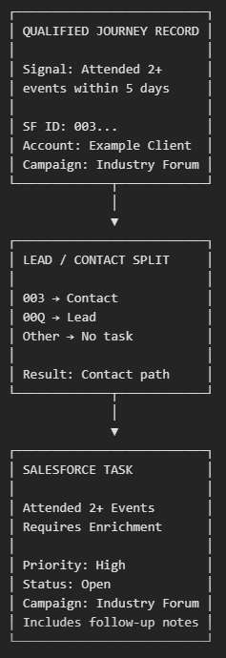
Journey Activation and Salesforce Task Experience
Journey Processing
Task Delivered to Salesforce
Examples of Task Subjects
Task-ready Data Extension acts as the Journey entry source
Decision Split routes each record to the Contact or Lead path
Journey creates the Salesforce Task and links it to the appropriate record
Unrecognized Salesforce ID formats follow a remainder path without task creation
Status: Open
Priority: High
Type: Pending Enrichment, where configured
Assigned to: Enrichment Queue, where applicable
Due date: Based on submission or activity date
Context included:
Inquiry or event type
User message or RFP comments
Account and Campaign
Restricted-account status
Follow-up comments
Source page URL for active handraisers
Global RFP Requires Enrichment
Attended 2+ Events - Requires Enrichment
Single In-Person Event Attended
Multiple Event Attendees from same Account
Notes:
This slide shows the final step, where qualified records enter Journey Builder and become actionable tasks in Salesforce Engage.
Journey Builder uses the Salesforce ID to route each record to either the Contact or Lead path. It then creates an Open, High-priority task linked to the appropriate record and, where applicable, assigns it to the Enrichment Queue.
The task includes the engagement signal, activity date, campaign and account context, restricted-account status, and relevant follow-up details, such as the form message or event comments.
The goal is to give the enrichment or sales team enough context to understand why the task was created and take the appropriate next action.

Slide 43
Campaign Member Status

Slide 44
Campaign Member Status Purpose and Lifecycle
What the Process Accomplishes
Examples of Statuses Processed
Business Outcome
Enrolled
Captures email, digital, event, form, and suppression activity generated across SFMC and related data sources.
Translates each activity into a standardized Campaign Member Status.
Updates an existing Campaign Member or creates one when no record currently exists.
Preserves the highest-priority qualifying status rather than allowing a lower-ranked activity to overwrite stronger engagement.
Makes engagement visible to account teams and sales stakeholders through Salesforce Campaign Members and downstream dashboards.
Email activity: Emailed, Email Click, Bounced
Digital and form activity: Web Contact Engaged, Form Submit
Non-email activity: Registered, Attended, Cancelled
Suppression activity: Opt Out, Competitor, KAM, Account Dormancy, Invalid Email, International/EU/Government, and Alliance
A Campaign Member record reflects the individual’s most relevant known interaction with a campaign, improving marketing visibility, follow-up context, and campaign attribution.
Emailed
Email Click /Web Engagement
Form Submit/ Registered
Attended

Slide 45
How SFMC Collects and Standardizes Activity
Campaignmember-validateupdatestatus
Collects recent activity from multiple sources:
Emailed: SFMC _Sent data view joined to MasterSendLog
Bounced: SFMC _Bounce data view joined to MasterSendLog, with qualification for significant bounce types and defined SMTP errors
Email Click: SFMC _Click data view joined to MasterSendLog
Non-email engagement: NonEmailEngagedActivities, including registration, attendance, cancellation, web engagement, and form activity
Suppressed activity: Standardized suppression records from the consolidated suppression process
The process uses a 180-day activity window, requires valid Campaign IDs, and maps each source activity to a standardized status and rank. Salesforce ID is prioritized as the Subscriber Key when available; otherwise, email or the original subscriber identifier is used during staging.
Campaignmember-SuppressedStatusessConsolidation
Collects recent activity from multiple sources:
Emailed: SFMC _Sent data view joined to MasterSendLog
Bounced: SFMC _Bounce data view joined to MasterSendLog, with qualification for significant bounce types and defined SMTP errors
Email Click: SFMC _Click data view joined to MasterSendLog
Non-email engagement: NonEmailEngagedActivities, including registration, attendance, cancellation, web engagement, and form activity
Suppressed activity: Standardized suppression records from the consolidated suppression process
The process uses a 180-day activity window, requires valid Campaign IDs, and maps each source activity to a standardized status and rank. Salesforce ID is prioritized as the Subscriber Key when available; otherwise, email or the original subscriber identifier is used during staging.
Key Staging Flow
Activity records first enter RK_CM_WithOutPK.
Suppression records move through SuppressedStatusesConsolidation, AllSupressedStatuses, and AllSupressedStatuses_With_PK.
Records are standardized before status comparison and Journey processing.

Slide 46
How SFMC Collects and Standardizes Activity
2 visuals here
ENGAGEMENT LANE
Sent | Bounce | Click | Non-email Activity
↓
RK_CM_WithOutPK
SUPPRESSION LANE
Opt Out | Competitor| Invalid | Geographic
↓
SuppressedStatusesConsolidation
↓
AllSupressedStatuses
↓
AllSupressedStatuses_With_PK
↓
Common Validation Process

Slide 47
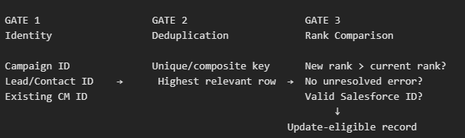
Status Ranking, Identity, and Update Controls
Identity and Matching
Activity is enriched with a Salesforce Lead or Contact ID.
The current implementation can match existing Campaign Members using:
Email address plus Campaign ID
Preferably, Lead/Contact ID plus Campaign ID for greater accuracy
The updated V2 logic uses LeadOrContactID and CampaignID, reducing the risk created by email changes, shared addresses, or inconsistent email matching.
Deduplication Prioritization
RecordKeeper_CampaignMember generates a unique identifier for each campaign member activity.
ROW_NUMBER logic retains the most relevant record within each Campaign, individual, and activity combination.
The incoming ActivityStatusRank is compared with the existing Salesforce CMS5StatusRank.
A record proceeds when the new activity rank is higher than the current Salesforce rank.
Errored records and records without a valid Lead or Contact ID are excluded from the eligible update population.
Historical Controls
CampaignMember_Historical_EnrolledSuppressed tracks previously processed Enrolled and Suppressed states.
A composite key combines Campaign ID, Lead/Contact ID, and status.
Records proceed when they are new, represent a meaningful rank progression, or contain an eligible active-engagement status.
This prevents repeated recreation of unchanged Enrolled or Suppressed records while retaining legitimate status progression.

Slide 48
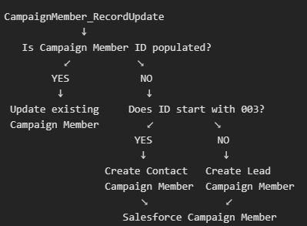
Journey Activation and Salesforce Campaign Member Result
Journey Entry
Existing Campaign Member Path
Qualified records are written to CampaignMember_RecordUpdate.
This Data Extension contains the Campaign ID, Lead/Contact ID, proposed Activity Status, status rank, existing Campaign Member ID, and supporting record information.
The Validate_Campaign_Member_Status Journey uses this dataset as its entry source
• When the Campaign Member Id is populated:
Journey Builder treats the record as an existing Campaign Member.
The existing record is located using the Campaign Member ID.
Salesforce Campaign Member Status is updated to the approved Activity Status
New Campaign Member Path
Audit and Recovery
• When the Campaign Member Id is null:
An ID beginning with 003 is routed to the Contact path.
The Journey creates a Campaign Member using:
CampaignID → CampaignId
LeadOrContactID → ContactId
ActivityStatus → Status
A non-003 Lead/Contact ID is routed to the Lead path, with LeadOrContactID written to LeadId.
The process therefore supports both Campaign Member updates and creation from a single Journey.
Recordkeeper Data Extensions preserve processed activity, current Salesforce status, ranks, identifiers, and errors.
Suppression recordkeepers provide a full audit view of consolidated and deduplicated suppression activity.
Error fields support troubleshooting and reconciliation when Salesforce processing does not complete successfully.

Slide 49
Thank you

